Slide 1
信號與系統
Signals & Systems
李琳山

Slide 2
A Signal
A signal is a function of one or more variables, which conveys information on the nature of some physical phenomena.
Examples
f ( t ) : a voice signal, a music signal
f ( x , y ) : an image signal, a picture
f ( x , y , t ) : a video signal
x_{n} : a sequence of data ( n: integer )
b_{n} : a bit stream ( b:1 or 0 )
continuous-time, discrete-time
analog, digital
Human Perceptible/Machine Processed

Slide 3
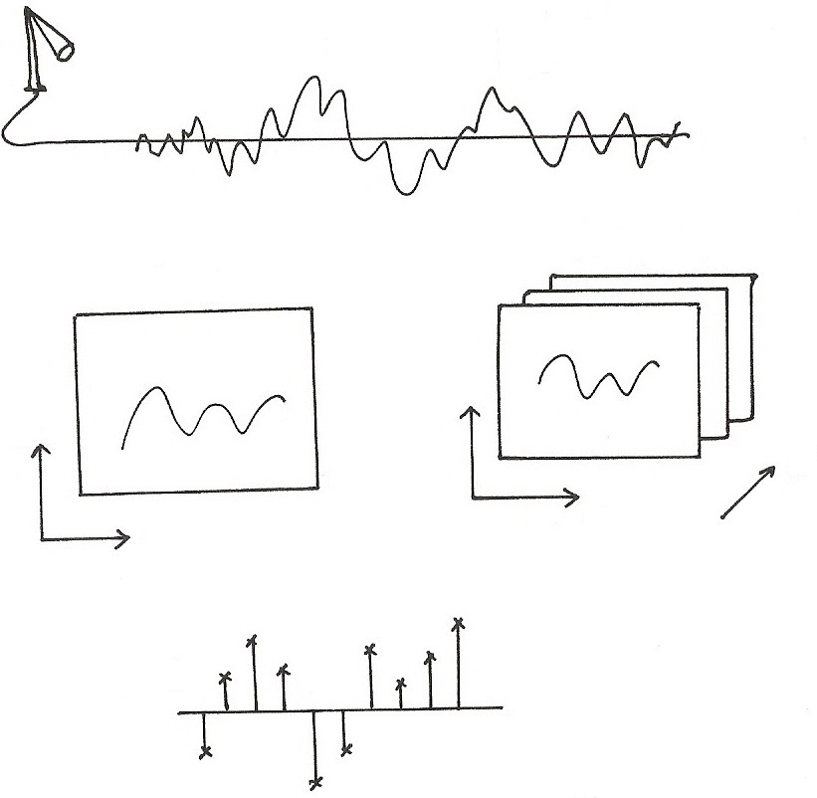











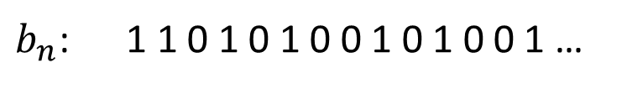
A Signal
$$f(t)$$
$$t$$
$$f(x,y, t)$$
$$f(x,y)$$
$$y$$
$$y$$
$$t$$
$$x$$
$$x$$
$$x_{n}$$
$$x[n]$$
$$n$$
$b_{n}$: 1 1 0 1 0 1 0 0 1 0 1 0 0 1 …

Slide 4
A System
An entity that manipulates one or more signals to accomplish some function, including yielding some new signals.
Examples
an electric circuit
a telephone handset
a PC software receiving pictures from Internet
a TV set
a computer with some software handling some data
System
input
signal
output
signal

Slide 5
Typical Examples of Signals/Systems
Concerned
Communication Systems
s(t)
r(t)
Transmitter
Channel
Receiver
Message signal (information) data, text, audio, video
Transmitted signal
Received signal
Estimate of message signal (information)
noise, loss
distortion,
interference

Slide 6
Typical Examples of Signals/Systems
Concerned
Computers
Signal Processing Systems
software systems processing the signal by computation/ memory
examples : audio enhancement systems, picture processing systems, video compression systems, voice recognition/ synthesis systems, array signal processors, equalizers, etc.

Slide 7
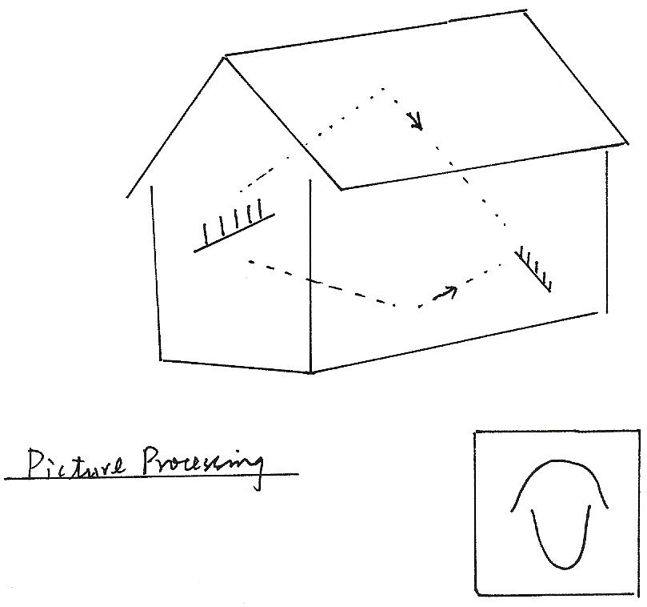
Audio Enhancement
Picture Processing

Slide 8
Typical Examples of Signals/Systems
Concerned
Networks
user B
user A

Slide 9
Typical Examples of Signals/Systems
Concerned
Information Retrieval Systems
Internet
Other Information Systems
examples : remote sensing systems, biomedical signal
processing systems, etc.
Internet
Search Engine
User

Slide 10
Internet
Internet
Digital
Libraries,
Virtual
Museums,
Electronic
Home,
Network
Entertainment
Google,
Facebook,
YouTube,
Amazon
Intelligent
Offices,
Distant
Learning,
Electronic
Commerce,
Network
Banking,
Electronic
Government
Services,
.
.
.
.
.
.
.
.
.
.
.
.
.
.
.
.
.
.

Slide 11
Internet
Network Technology Connects Everywhere Globally
Huge Volume of Information Disseminated across the Globe in Microseconds
Multi-media, Multi-lingual, Multi-functionality
Cross-cultures, Cross-domains, Cross-regions
Integrating All Knowledge Systems and Information related Activities Globally

Slide 12
Typical Examples of Signals/Systems
Concerned
Control Systems
close-loop/feedback control systems
disturbance z(t)
error signal e(t)
control signal v(t)
input signal x(t)
controller
plant
output signal y(t)
feedback signal
sensor
example: aircraft landing systems, satellite stabilization systems, robot arm control systems, etc.

Slide 13
Typical Examples of Signals/Systems
Concerned
Other Systems
manufacturing systems, computer-aided-design systems, mechanical systems, chemical process systems, etc.

Slide 14
Scope of The Course
Those Signals/Systems Operated by Electricity, in Particular by Software and Computers, with Extensive Computation and Memory, for Information and Control Primarily
Analytical Framework to Handle Such Signals/Systems
Mathematical Description/Representation of Such Signals/Systems

Slide 15
Scope of The Course
Language and Tools to Solve Problems with Such Signals/Systems
Closely Related to: Communications, Signal Processing, Computers, Networks, Control, Biomedical Engineering, Circuits, Chips, EM Waves, etc.
A Fundamental Course for E.E.

Slide 16
Text/Reference Books and Lecture Notes
Textbook:
Oppenheim & Willsky, “Signals & Systems”, 2nd Ed. 1997
Prentice-Hall, 新月
Reference:
S. Haykin & B.Van Veen, “Signals & Systems”, 1999
John Willey & Sons, 歐亞
Lecture Notes:
Available on web before the day of class

Slide 17
Course Outline
Fundamentals
Linear Time-invariant Systems
Fourier Series & Fourier Transform
Discrete Fourier Transform (DFT)
Time/Frequency Characterization of Signals/Systems
Sampling & Sampling Theorem
Communication Systems
Laplace Transform
Z-Transform
Linear Feedback Systems
Some Application Examples

Slide 18
History of the Area
Independently Developed by People Working on Different Problems in Different Areas
Fast Development after Computers Become Available and Powerful
Re-organized into an Integrated Framework

Slide 19
Background Required
2nd semester of 2nd year of EE
Mathematics
Pre-requisite : No
Grading
Midterm 35%
Final 35%
MATLAB Problems 20%
Homeworks 10%

Slide 20
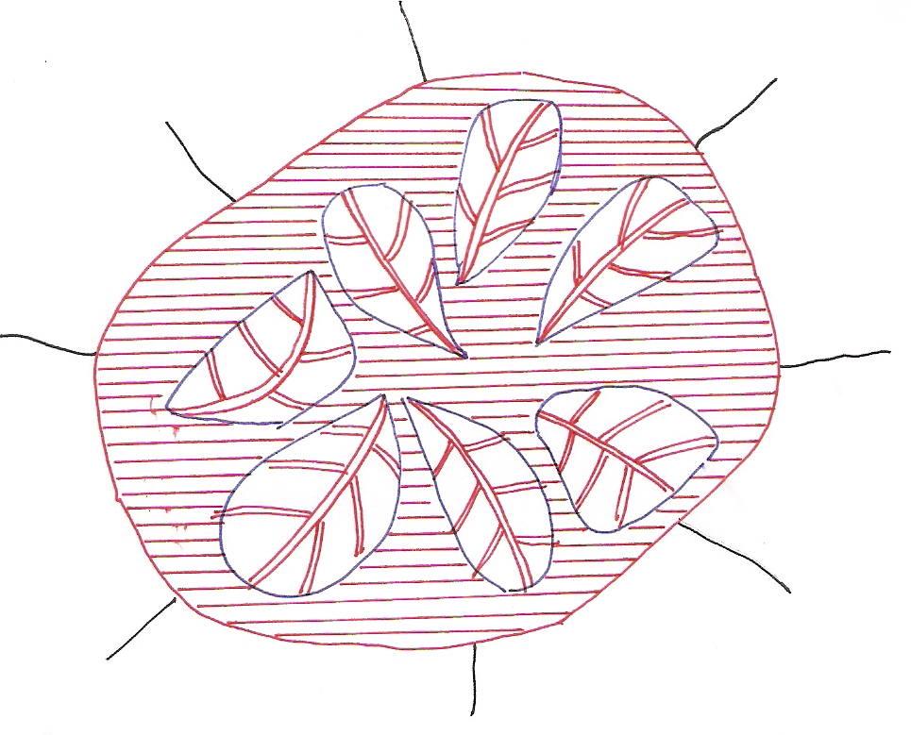
學習要領
網路導論
訊號處理
通訊原理
控制系統
線性代數
電子學
電路學
微分方程
每週準時上課認真聽講，不遲到缺席
每週自行閱讀課本，跟上上課進度
課本中上課未能提到之處，自行仔細研讀(含例題、習題)

Slide 21
1.0 Fundamentals
1.1 Signals
Continuous/Discrete-time Signals
x(t), x[n]
Signal Energy/Power

Slide 22
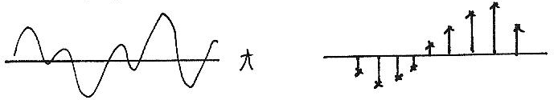
Continuous/Discrete-time
x(t)
x[n]
t
n

Slide 23
Transformation of A Signal
Time Shift
Time Reversal
Time Scaling
Combination

Slide 24
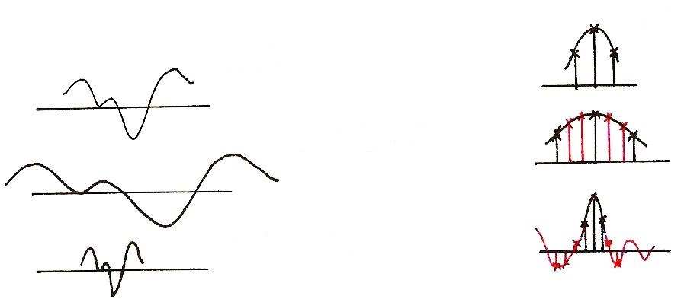
Time Scaling
x[n]
x(t)
?
x(at), a<1
?
x(at), a>1

Slide 25
Periodic Signal
T₀ : Fundamental period : the smallest positive value of T
aperiodic : NOT periodic

Slide 26
Even/Odd Signals
Even
Odd
Any signal can be discomposed into a sum of an
even and an odd

Slide 27
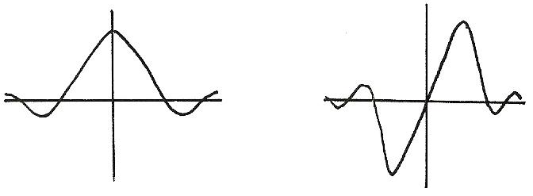
Even/Odd
Even
Odd
x(-t)=x(t)
x(-t)=-x(t)

Slide 28
Exponential/Sinusoidal Signals
Basic Building Blocks from which one can construct many different signals and define frameworks for analyzing many different signals efficiently
fundamental period
fundamental frequency

Slide 29
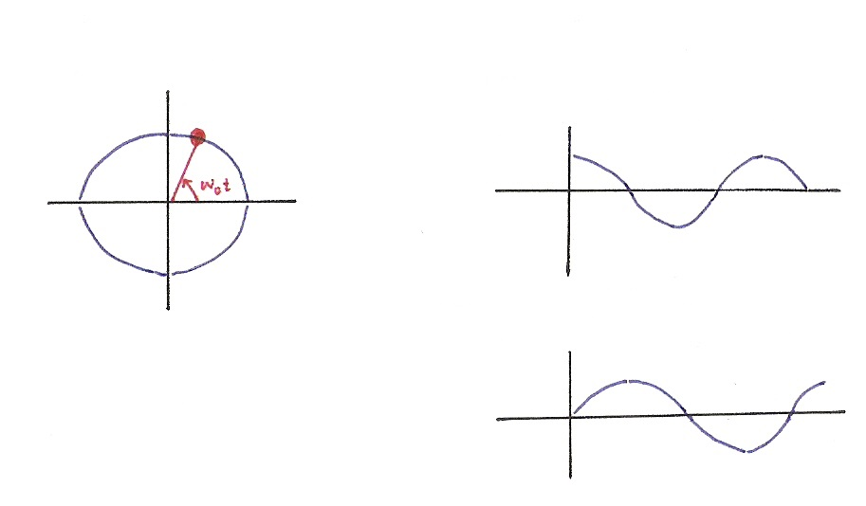






Exponential/Sinusoidal Signals
$$x\left(t\right)=e^{jω_{0}t}$$
$$Re\left\{e^{jω_{0}t}\right\}=\cos{ω_{0}t}$$
$$Im$$
$$Re$$
$$Im\left\{e^{jω_{0}t}\right\}=\sin{ω_{0}t}$$
$$e^{jx}=\cos{x}+j sin{x}$$

Slide 30
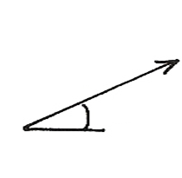
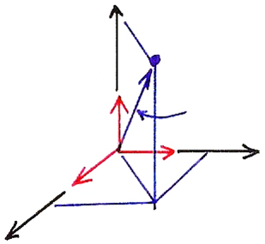

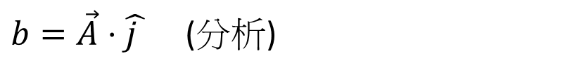
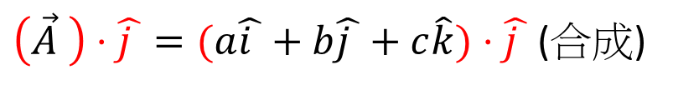




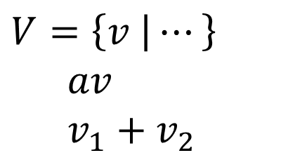

Vector Space
$$V=\left\{v | ⋯\right\}$$
$av$
$v_{1}+$ $v_{2}$
$$b$$
$$θ$$
3-dim Vector Space
$\left(\vec{A} \right)⋅\hat{j }=(a\hat{i }+b\hat{j }+c\hat{k})⋅\hat{j }$ (合成)
$$\hat{k}$$
$$\vec{A}$$
$b=\vec{A}⋅\hat{j }$ (分析)
$$\hat{i }$$
$$\hat{j }$$

Slide 31

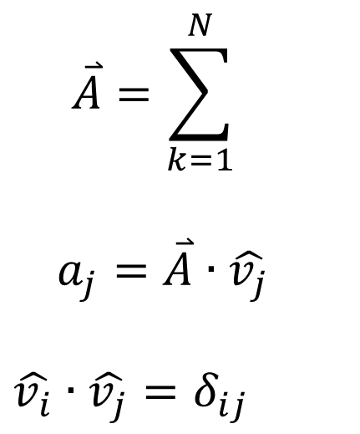

N-dim Vector Space
$$\overset{⃑}{A}=\sum_{k=1}^{N}{}$$
$a_{j}=\overset{⃑}{A}∙\hat{v_{j}}$
$$\hat{v_{i}}∙\hat{v_{j}}=δ_{ij}$$
(合成)
$$a_{k}$$
$${\hat{v}}_{k}$$
(分析)

Slide 32
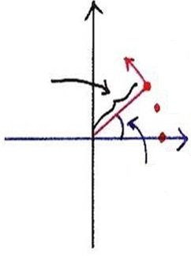
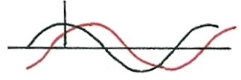
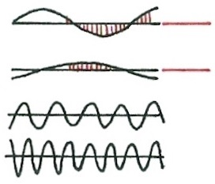












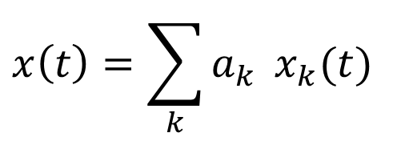










Signal Analysis
$$x\left(t\right)=\sum_{k}{a_{k}} x_{k}(t)$$
$$t=n$$
$$t=n$$
$$x_{k}\left(t\right)=Re\left\{ e^{jω_{k}t} \right\}={ \cos{ω}}_{k}t$$
$$a_{k}=A_{k}e^{jφ_{k}}$$
$$t=n$$
$$Re\left\{\left(A_{k}e^{jφ_{k}}\right) \left(e^{jω_{k}t}\right)\right\}=A_{k}\cos{(ω_{k}t+φ_{k})}$$
$$Im$$
$$n$$
$$ω_{k}$$
$$t$$
$$n$$
$$A_{k}$$
$$n=2$$
$$0$$
$$t$$
$$t$$
$$n=1$$
$$t$$
$$Re$$
$$ω_{k}=kω_{0}$$
$$t$$
$$n=0$$
$$φ_{k}$$

Slide 33
Exponential/Sinusoidal Signals
Harmonically related signal sets
fundamental period
fundamental frequency
all with common period

Slide 34
Exponential/Sinusoidal Signals
Sinusoidal signal
General format
Discrete-Time

Slide 35
Exponential/Sinusoidal Signals
Important Differences Between Continuous-time and Discrete-time Exponential/Sinusoidal Signals
For discrete-time, signals with frequencies ω₀ and
ω₀ +m．2π are identical. This is Not true for
continuous-time.
see : Fig.1.27, p.27 of text

Slide 36
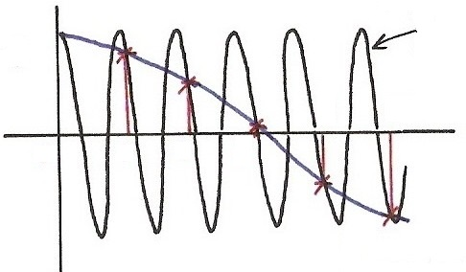
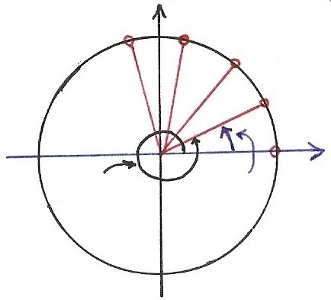
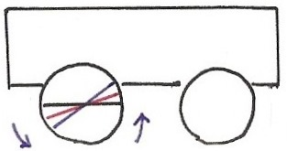



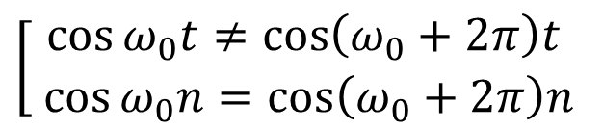











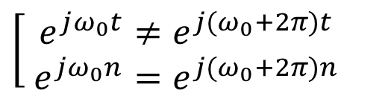


Continuous/Discrete Sinusoidals
$$\cos{[\left(ω_{0}+2π\right)t]}$$
$$(t=n)$$
$$\cos{[⋅]}$$
$$\left[\begin{aligned}\cos{ω_{0}t}≠\cos\left(ω_{0}+2π\right)t \\ \cos{ω_{0}n}=\cos\left(ω_{0}+2π\right)n\end{aligned}\right.$$
4
5
$$t,n$$
0
1
2
3
$$\left[\begin{aligned} e^{jω_{0}t}≠e^{j{(ω}_{0}+2π)t} \\ e^{jω_{0}n}=e^{j{(ω}_{0}+2π)n}\end{aligned}\right.$$
$$\cos{[ω_{0}t]}$$
$$(t=n)$$
$$Im$$
$$n=4$$
$$n=3$$
$$n=2$$
$$e^{j[⋅]}$$
$$n=1$$
$$Re$$
$$ω_{0}t$$
$$n=0$$
$${(ω}_{0}+2π)t$$

Slide 37
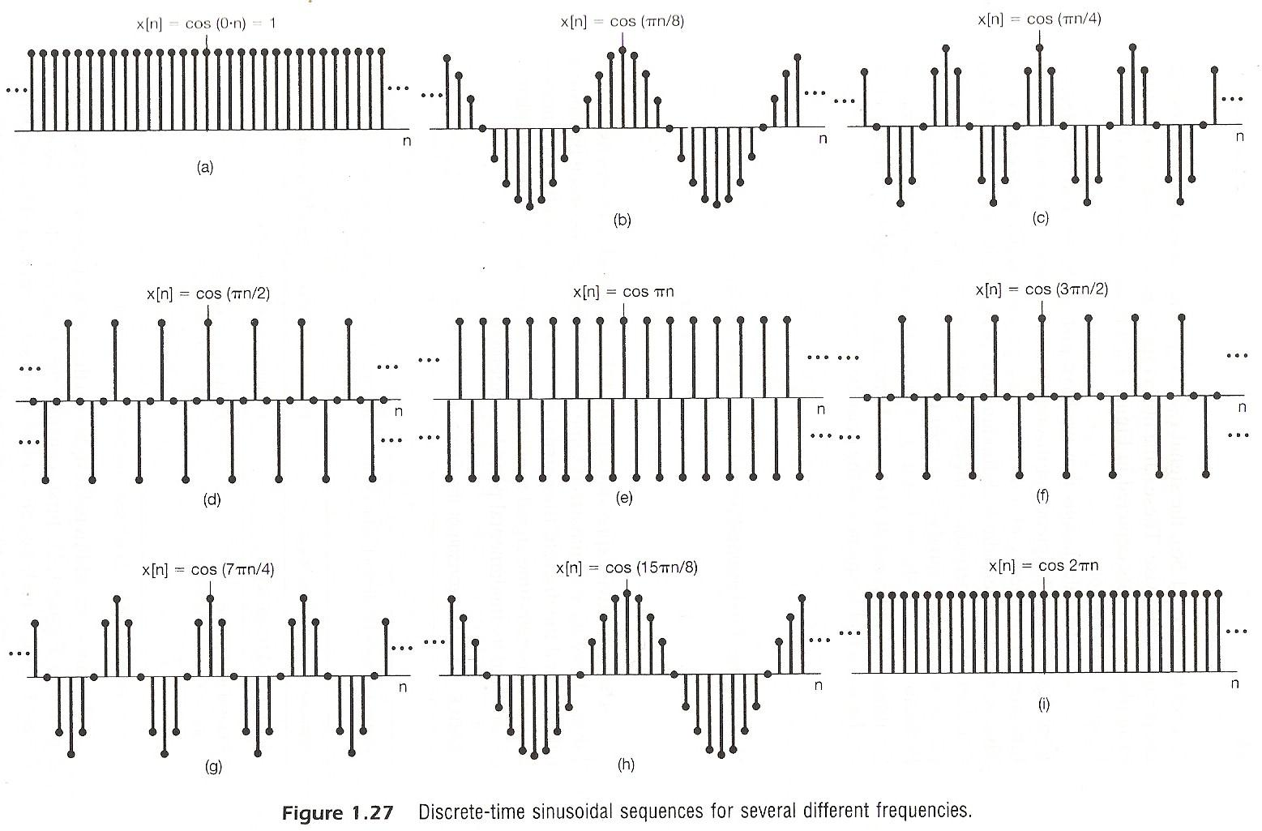

Slide 38
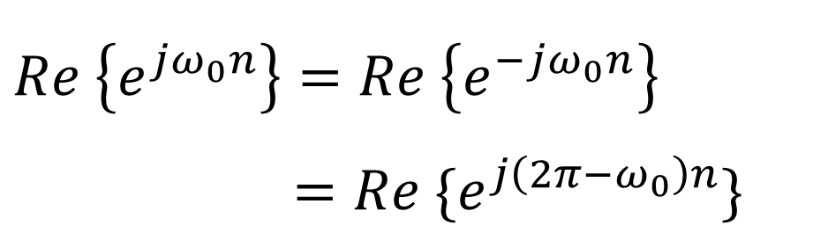
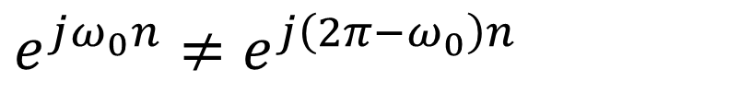
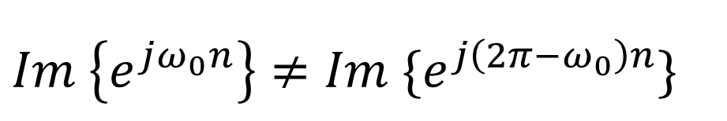
Fig. 1.27
$$e^{jω_{0}n}≠e^{j\left({2π−ω}_{0}\right)n}$$
but
$$Re \left\{e^{jω_{0}n}\right\}=Re \left\{e^{−jω_{0}n}\right\}$$
$=Re \{e^{j\left({2π−ω}_{0}\right)n}\}$
Note:
$$Im \left\{e^{jω_{0}n}\right\}≠Im \{e^{j\left({2π−ω}_{0}\right)n}\}$$

Slide 39
Exponential/Sinusoidal Signals
Important Differences Between Continuous-time and Discrete-time Exponential/Sinusoidal Signals
For discrete-time, ω₀ is usually defined only for [-π, π] or [0, 2π]. For continuous-time, ω₀ is defined for (-∞, ∞)
For discrete-time, the signal is periodic only when
ω₀N=2πm,
see : Fig.1.25, p.24 of text

Slide 40
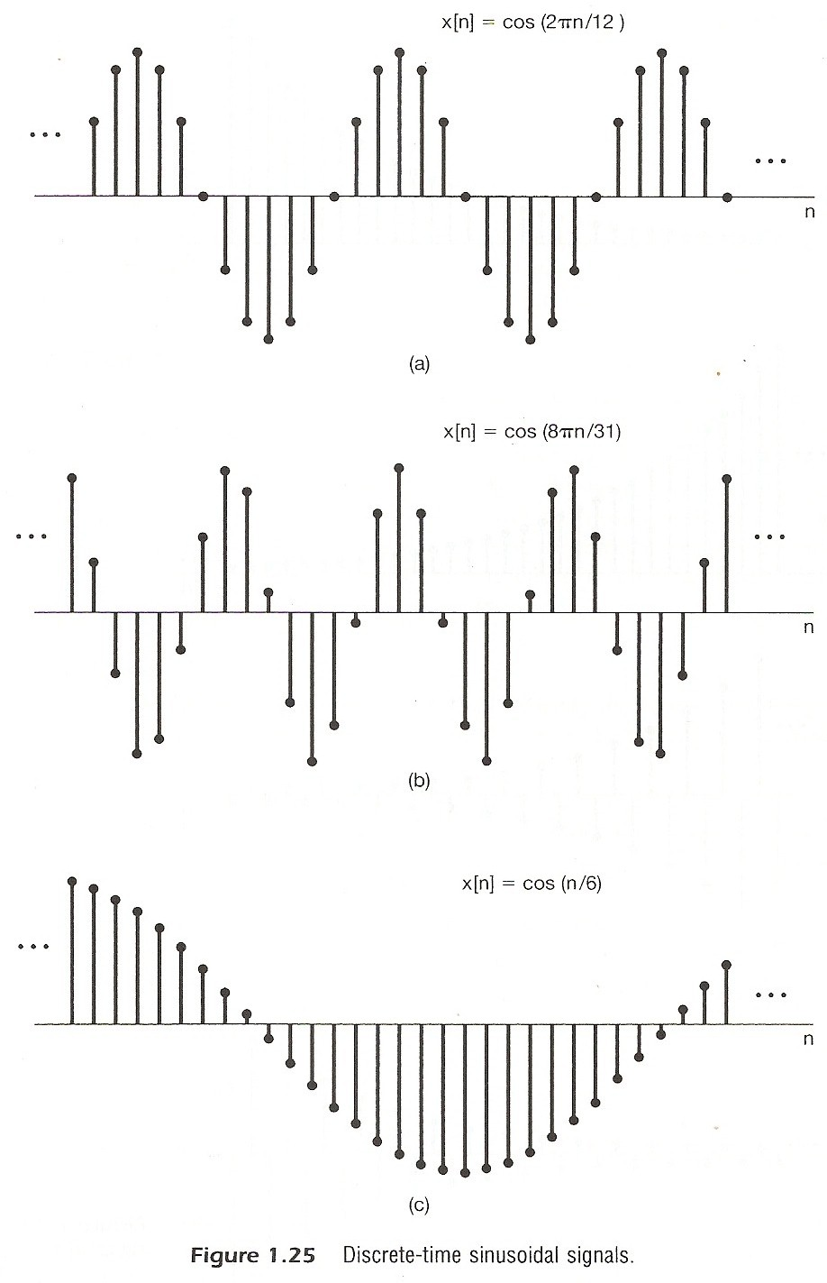

Slide 41
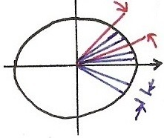
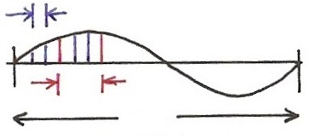
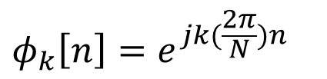










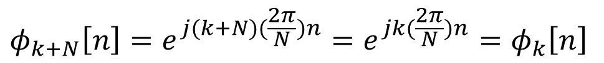

Harmonically Related Signal Sets
For being periodic
real period in cycles
$$=$$
$$ω_{k}⋅N=2π⋅k$$
$$ω_{k}=k(\frac{2π}{N})$$
$$=$$
real period in n
$$Im$$
$$\frac{2π}{N}$$
$$k\left(\frac{2π}{N}\right), k=3$$
$$Re$$
$$k\left(\frac{2π}{N}\right), k=3$$
$$2π$$
divided in N
$$\frac{2π}{N}$$
$$φ_{k}\left[n\right]=e^{jk(\frac{2π}{N})n}$$
$$φ_{k+N}\left[n\right]=e^{j(k+N)(\frac{2π}{N})n}=e^{jk(\frac{2π}{N})n}=φ_{k}\left[n\right]$$

Slide 42
Exponential/Sinusoidal Signals
Harmonically related discrete-time signal sets
all with common period N
This is different from continuous case. Only N distinct signals in this set.

Slide 43
Unit Impulse and Unit Step Functions
Continuous-time
First Derivative
see: Fig1.33, Fig1.34, P,33 of text
Running Integral
Sampling property

Slide 44
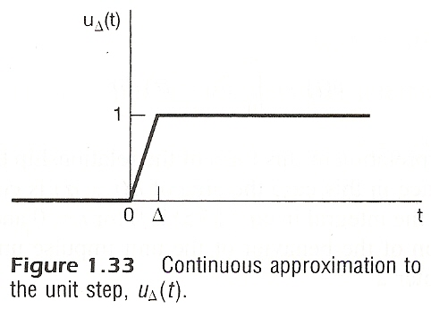
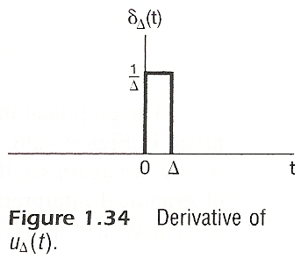

Slide 45
Unit Impulse and Unit Step Functions
Discrete-time
First difference
Running Sum
Sampling property

Slide 46
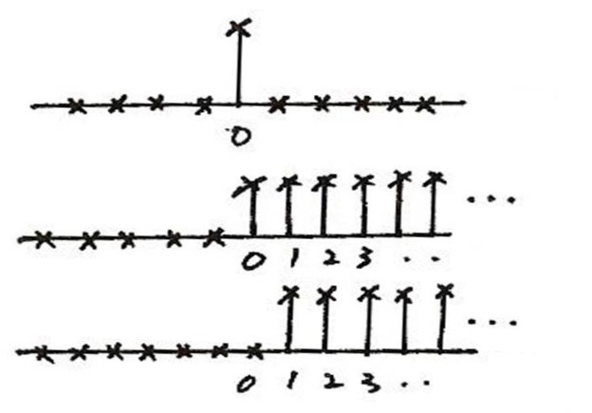
Unit Impulse & Unit Step
Discrete-time
δ [n]
n
u [n]
n
u [n – 1]
n
δ [n] = u[n] – u[n – 1]

Slide 47
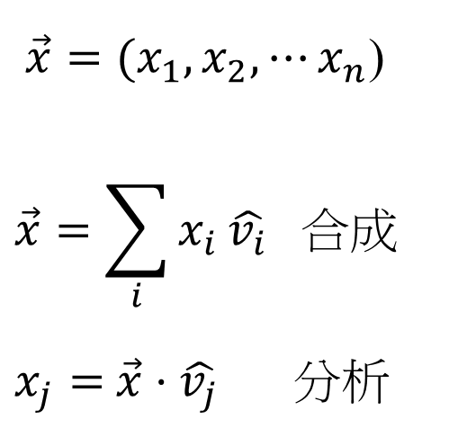
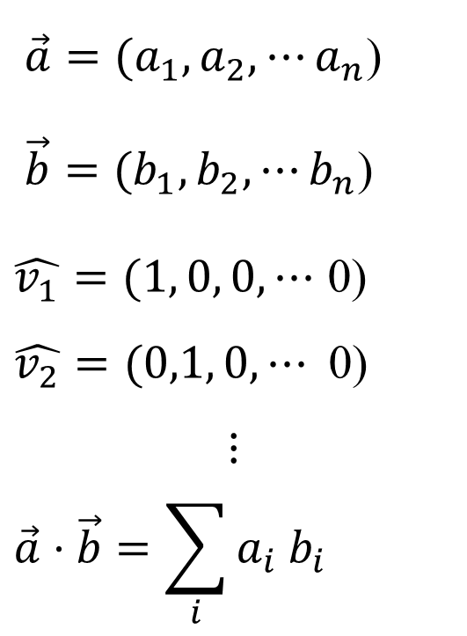
Vector Space Representation of Discrete-
time Signals
n-dim
$\vec{a}=(a_{1},a_{2}, ⋯a_{n}$)
$\vec{b}=(b_{1},b_{2}, ⋯b_{n}$)
$\hat{v_{1}}=(1, 0, 0,⋯$ 0)
$$\hat{v_{2}}=(0,1, 0,⋯\text{ 0)}$$
$$⋮$$
$$\vec{a}⋅\vec{b}=\sum_{i}{a_{i}{ b}_{i}}$$
$\vec{x}=(x_{1},x_{2}, ⋯x_{n}$)
$$\vec{x}=\sum_{i}{x_{i}}\hat{v_{i}} 合成$$
$x_{j}=$ $\vec{x}⋅\hat{v_{j}}$ 分析

Slide 48

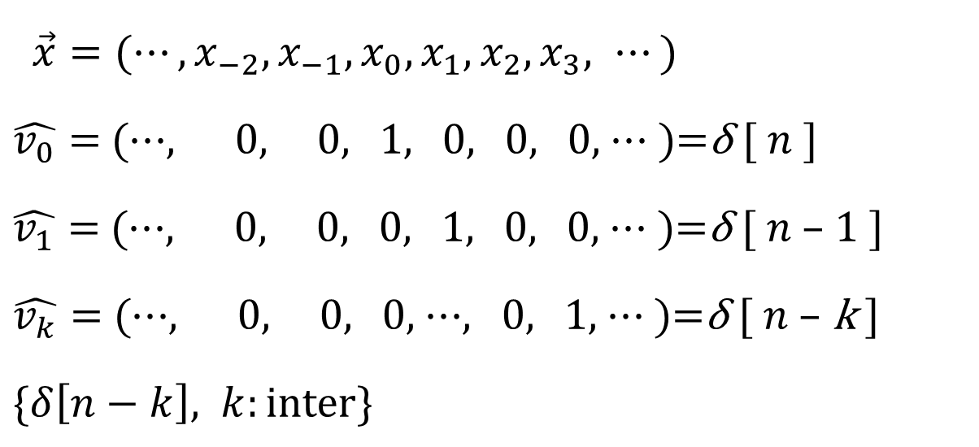
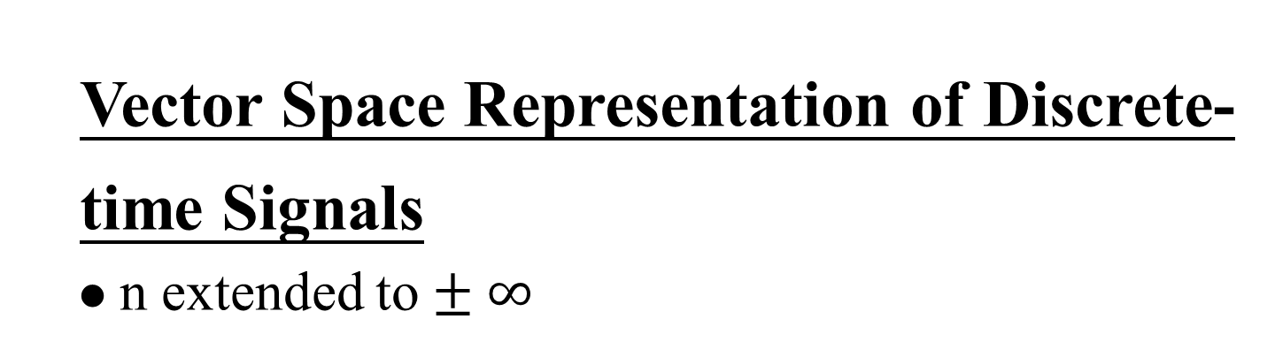
Vector Space Representation of Discrete-
time Signals
n extended to $± ∞$
$\vec{x}=(⋯,x_{−2},x_{−1},x_{0},x_{1},x_{2},x_{3}, ⋯)$
$\hat{v_{0}}=$ (⋯, 0, 0, 1, 0, 0, 0, ⋯ )=δ [ $n$ ]
$\hat{v_{1}}=$ (⋯, 0, 0, 0, 1, 0, 0, ⋯ )=δ [ $n$ – 1 ]
$\hat{v_{k}}=$ (⋯, 0, 0, 0, ⋯, 0, 1, ⋯ )=δ [ $n$ – k ]
$\{δ\left[n−k\right], k:\text{inter}\text{\}}$
$$\vec{x}=\sum_{i}{x_{i}\hat{v_{i}}} 合成$$
$x_{j}= \vec{x}⋅\hat{v_{j}}$ 分析

Slide 49
1.2 Systems
Continuous/Discrete-time Systems
Interconnections of Systems
Series
Parallel
x(t)
y(t)
x[n]
y[n]
+

Slide 50
Interconnections of Systems
Feedback
Combinations
+

Slide 51
Stability
stable : bounded inputs lead to bounded outputs
Time Invariance
time invariant : behavior and characteristic of the system are fixed over time

Slide 52
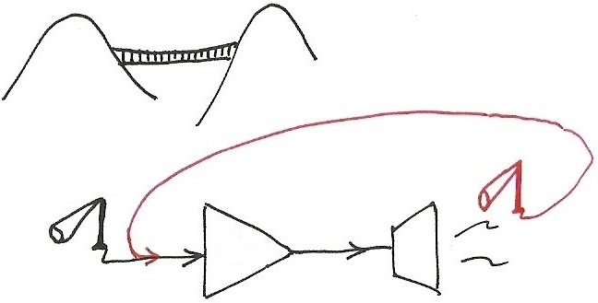
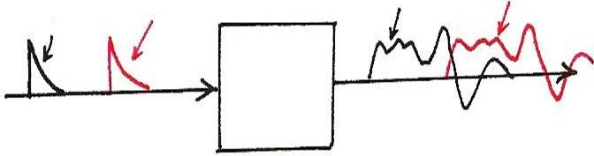
Stability
Examples of unstable systems
Amp
Time Invariance
x(t-T₀)
y(t)
y(t-T₀)
x(t)

Slide 53
Linearity
linear : superposition property
scaling or homogeneity property
additive property

Slide 54
Memoryless/With Memory
Memoryless : output at a given time depends only on the input at the same time
eg.
With Memory
eg.

Slide 55
Invertibility
invertible : distinct inputs lead to distinct outputs, i.e. an inverse system exits
eg.
Causality
causal : output at any time depends on input at the same time and in the past
eg.

Slide 56
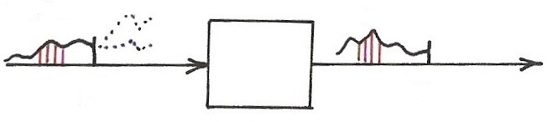

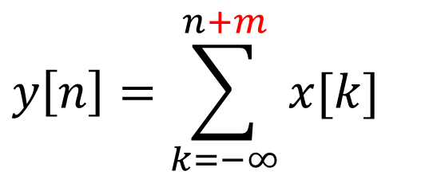



Causality
$$x[n]$$
$$y[n]$$
$$n$$
$$n$$
$$y\left[n\right]=\sum_{k=−∞}^{n+m}{x[k]}$$

Slide 57
Examples
Example 1.12, p.47 of text
Example 1.13, p.49 of text
“NOT” causal
causal
unstable
stable

Slide 58
Examples
Example 1.20, p.55 of text
zero input leads to zero output for linear systems
incrementally linear: difference between the responses to any two inputs is a linear function of the difference between the two inputs
“NOT” linear

Slide 59
Problem 1.35, p.64 of text
.
a has to divide N for N₀ being an integer and N₀ ≤ N
a has to divide k for m being an integer
a=gcd(k, N), N₀ =N/gcd(k, N)
example: N=12, k=3, N₀ =4, m=1
N=12, k=9, N₀ =4, m=3
Selected problems for chap1: 4, 9, 14, 16, 18, 19, 27, 30, 35, 37, 47
fundamental period=?
,

